Slide 1
Logistic Regression
Predicting Healthy Loans using the Logistic Regression Model

Slide 2
What is Logistic Regression?
geeksforgeeks.com defines Logistic Regression as:
A supervised machine learning algorithm used for classification tasks where the goal is to predict the probability that an instance belongs to a given class or not. Logistic regression is a statistical algorithm which analyzes the relationship between two data factors.

Slide 3
What are we trying to achieve?
The goal of this notebook is to predict healthy loans and high-risk loans.
Identifying healthy and high-risk loans is crucial for financial institutions to manage risk effectively and make informed lending decisions. The logistic regression model is one of the statistical techniques commonly used for this purpose due to its ability to predict the probability of a binary outcome, such as whether a loan will default or not.

Slide 4
Steps of the Process:
1. Prepare the data
2. Split the data into training and testing sets
3. Model and fit the data into a logistic regression model
4. Predict the testing labels
5. Calculate the performance metrics
6. Predict a Logistic Regression Model with Resampled Training Data

Slide 5
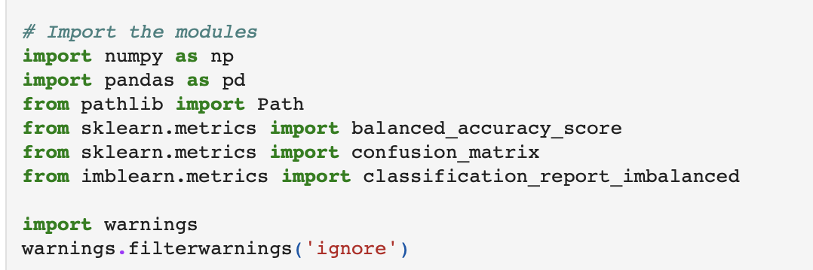
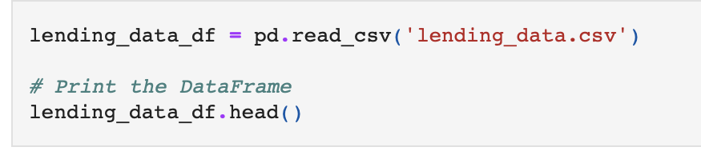
Preparing the Data
The first step in preparing the data is:
1.) Importing your necessary modules and libraries
2.) Reading in your data.

Slide 6
Basic Steps
Anytime you are using data to make predictions, you have 4 basic steps:
Train, test, split
Model
Fit
Predict

Slide 7
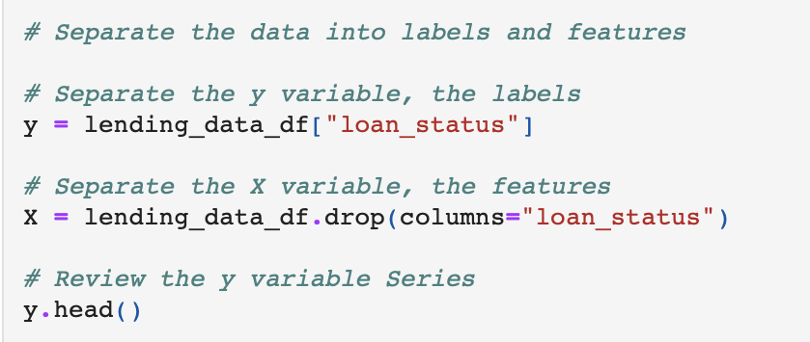
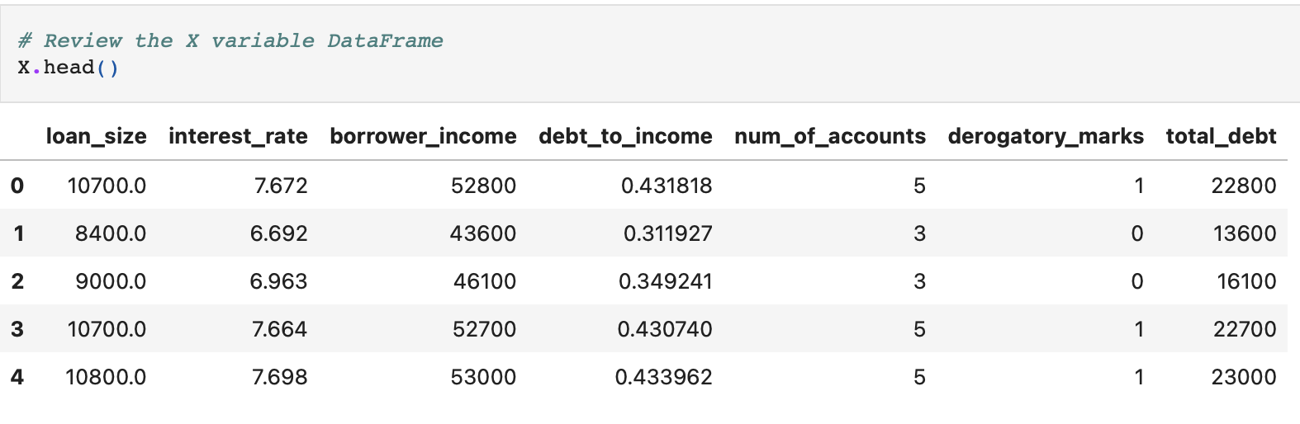
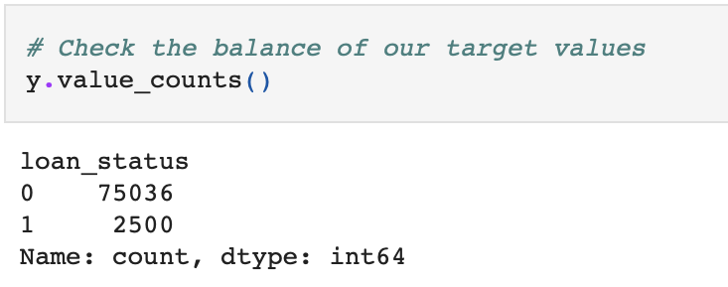
Splitting X and y
Why is it important?
In logistic regression, X represents the independent variables or predictors, while y represents the dependent variable or the outcome we're trying to predict.

Slide 8
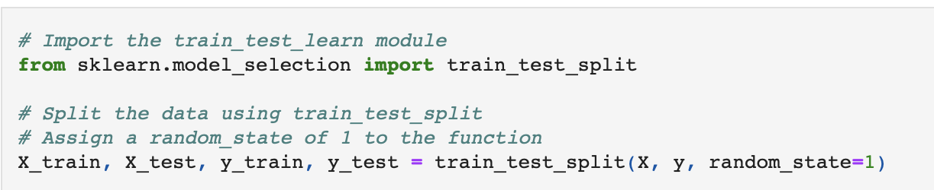
Train, Test, Split
The purpose of train-test split in logistic regression (and in machine learning in general) is to evaluate how well the model will perform on unseen data.

Slide 9
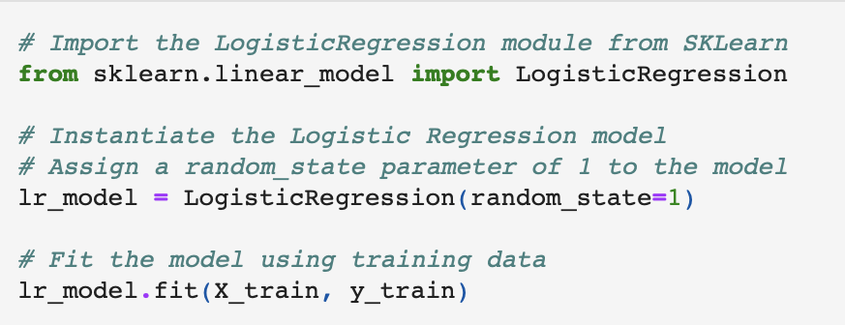
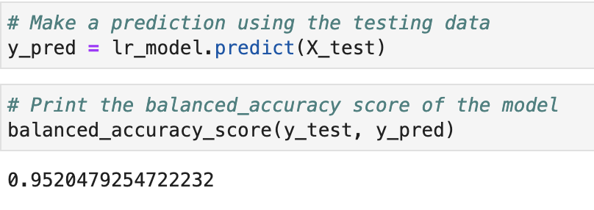
Model, Fit, Predict
The model, fit, and predict functions collectively represent the workflow of building a logistic regression model:
Defining the model
Training it on data
Using it to make predictions on new data.

Slide 10
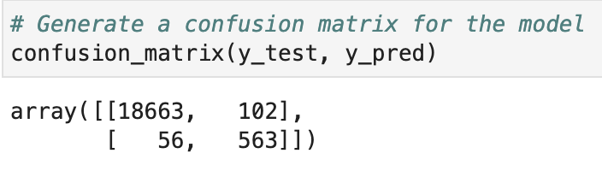
Applying a Confusion Matrix
Why are we applying a confusion matrix?
Because the confusion matrix serves as a powerful tool for evaluating, fine-tuning, and interpreting logistic regression models, which in turn enhances their effectiveness in real-world applications.

Slide 11
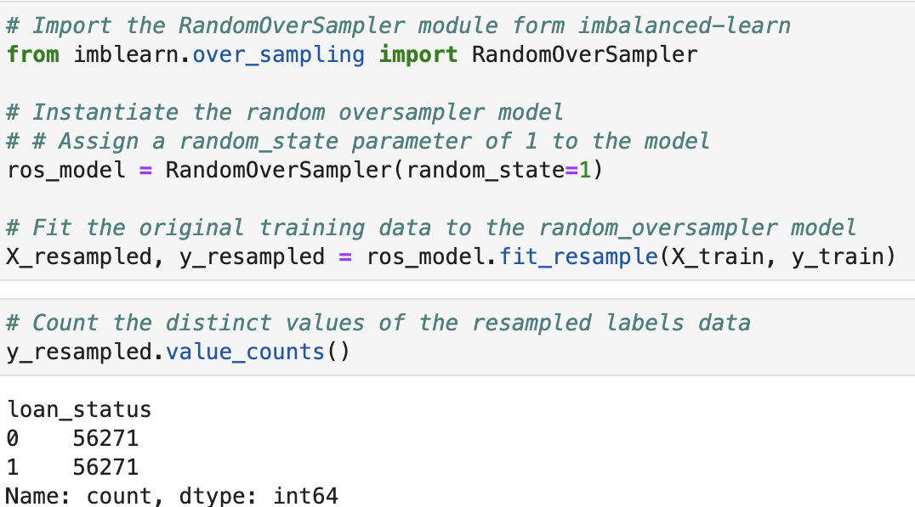
Importing a RandomOverSampler module & Resampling
To the right, you can see how we imported a RandomOverSampler module and then resample the data to see if we can get better results.

Slide 12
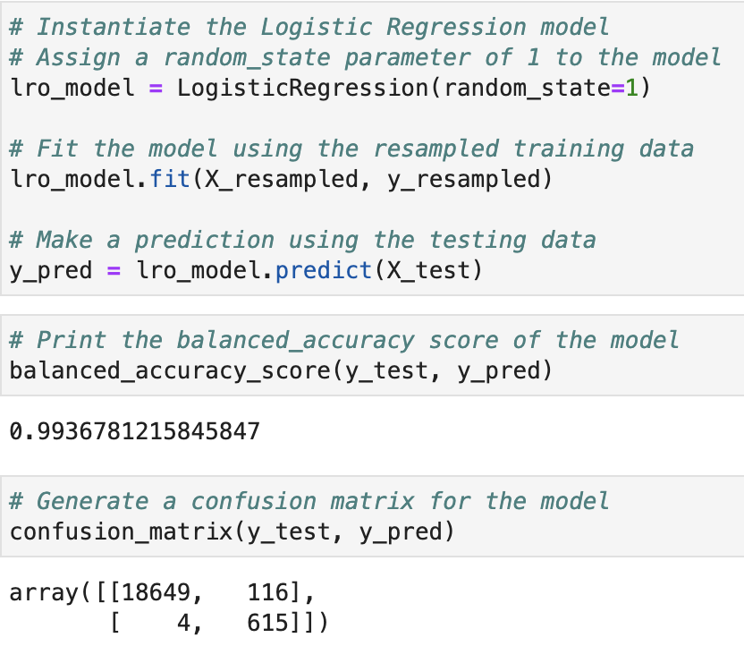
Model, Fit, Predict, and apply Confusion Matrix
Now that we have applied a RandomOverSampler module, and Resampled our data, it is time to repeat the Model, Fit, Predict steps again.

Slide 13
Let’s check out how our well these models predicted healthy and high-risk accounts.

